Slide 1
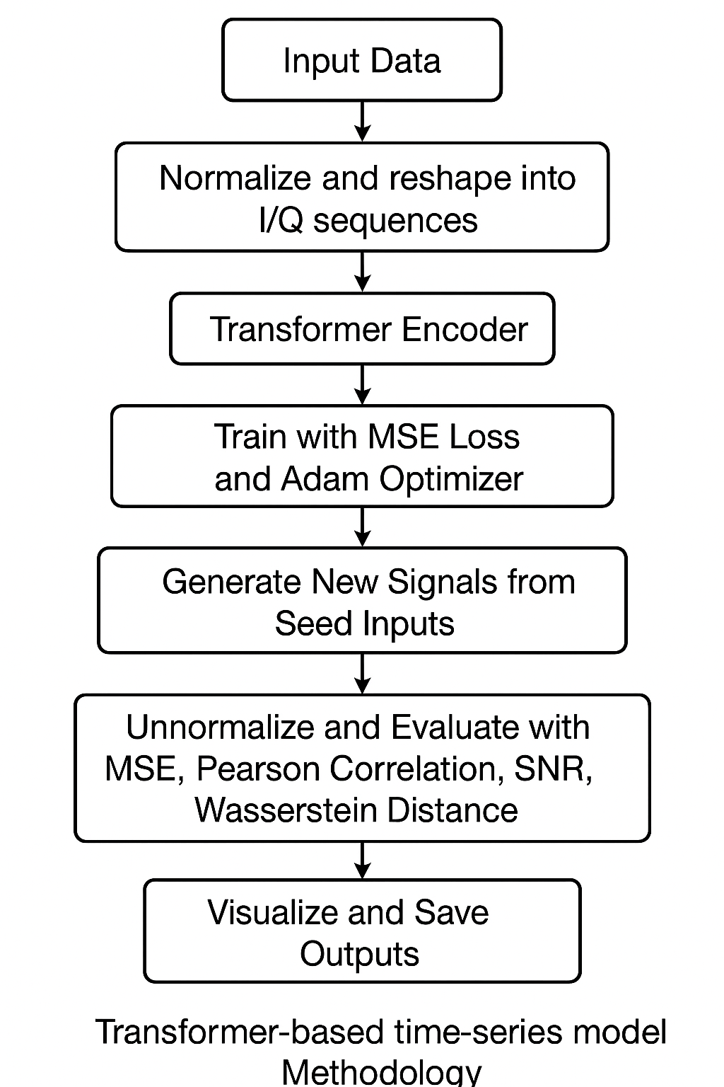
TEAM: 8
Title: Time-Series Signal Generation Using Time Transformer
Problem statement:
Methodology:
Figure 1. Workflow of our model.
In modern wireless communication systems, the ability to synthesize realistic modulated signals is critical for system design, testing, and AI-driven signal classification. Existing methods rely on traditional modulation techniques, which limit adaptability and realism under varying channel conditions. Our project proposes a generative AI framework using Time Transformer models to generate modulated signal samples by first identifying the most appropriate modulation type for a given input and then generating the signal accordingly. This approach will enhance data augmentation pipelines, improve training robustness of modulation classifiers, and open new possibilities in AI-driven communication systems.
Objectives:
To develop a Time Transformer-based generative model capable of synthesizing realistic modulated signal samples from input base signals.
To automatically identify and apply suitable modulation techniques (e.g., BPSK, QPSK, QAM) based on the characteristics of the input data.
Approach and model architecture:
Dataset: RadioML
Model: Time Transformer
Implementation: Implemented using time transformer model
Evaluation: MSE, Pearson Correlation, SNR, Wasserstein Distance
Reference paper:
Yildirim, I., Basar, E., & Altunbas, I. (2017). Quadrature Channel Modulation. IEEE Wireless Communications Letters, 6(6), 790–793.
Time-Transformer: Integrating Local and Global Features for Better Time Series Generation

